Slide 1
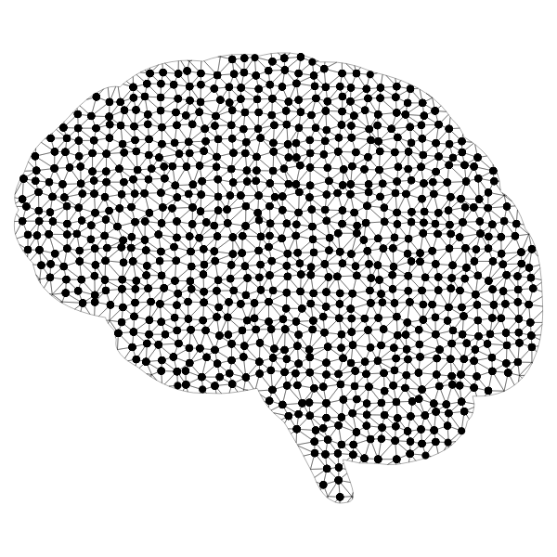

Finalizing Your AI Tool in MATLAB

Slide 2
Reviewing How to Create an AI Model
The goal of the final project is to create and train an AI model that can process data to identify the next start of the sports or music industry. In Lessons 7 and 8, you were provided with the foundation necessary for creating a working AI model.
Let’s begin by reviewing the steps introduced in Lesson 7. Feel free to reference Lesson 7 material when completing the activity below.
Make a list of the steps outline in Lesson 7 and write one sentence describing the importance of each step. (Hint: There are 6 general steps to create an AI model)
Get into groups to compare and discuss your responses with other students.
Now that you have reviewed the 6 six general steps to create an AI model. Take some time to look at Lesson 8 to remember how to evaluate your AI model.
Get into groups to compare and answer the following questions:
What metrics are used to evaluate classification models and what do they tell you about the model?
What metrics are used to evaluate regression models and what do they tell you about the model?

Slide 3
Peer Review
Now that you have reviewed the material in Lessons 7 and 8, it is time to determine how you can improve your current AI model!
To accomplish this, you will work together with other groups to provide each other with feedback. For the following activity you will be in groups of two and complete the following 4 times, each time with a different partner in your group:
Make groups of two to review each other’s AI Model and take notes on its functionality.
Make sure to consider the 6 steps you wrote down at the beginning of class in addition to the metrics used to evaluate models.
Take a few minutes to provide constructive feedback on your partner’s AI Model
Please answer the guiding questions for this activity on your handout for each peer review.

Slide 4
Peer Review
Download the PEER REVIEW HANDOUT to answer the following guiding questions:
Answer these questions for each peer review and suggest how each aspect can be improved.
What does the model use to determine if an athlete or musician is successful? Are there any limitations with using this metric to define success?
How was the model supplied with data?
Are the steps used to prepare data appropriately? Are response variables and predictor variables properly identified?
Was the data split into reasonable training and testing sets?
What type of model was selected? Is the use of this model type justified?
What metric is being used to evaluate the model? Is the metric selected appropriate for this type of model?
Please make sure that you provide your peers with thorough feedback to help them improve their AI model!

Slide 5

Action Plan
Now that you have received feedback from others it is time to create a plan to implement the feedback into your AI model.
First gather with your group and read through all the peer review handouts you received.
While reading the feedback highlight suggestions that appear more than once.
Begin working on revising your model once your group has decided what must be done.
While revising your model feel free to consult other groups and ask questions.

